Slide 1
Streaming Wars Subreddit Analysis
Irvan Indra Wahab

Slide 2

Disney+ Team
The Walt Disney Company

Slide 3
Agenda
01
02
03
04
05
06
Introduction
Methodology
Data Preparation
Problem statement, overview, and objectives
Data science process and procedure
Data collection, cleaning and preprocessing
EDA
Modeling
Evaluation
Data exploration and visualization
Model selection, training, and hyperparameter tuning
Model performance evaluation and recommendation

Slide 4
01
Introduction
Problem statement, overview, and objectives

Slide 5
Problem Statement
Overview
Problem
Objective
Disney+ was launched in Nov-2019, and has quickly become a major player in the streaming industry
Formidable challenge to effectively compete with Netflix’s market dominance
Gain understanding of public perception, user preferences, and emerging trends through Reddit

Slide 6

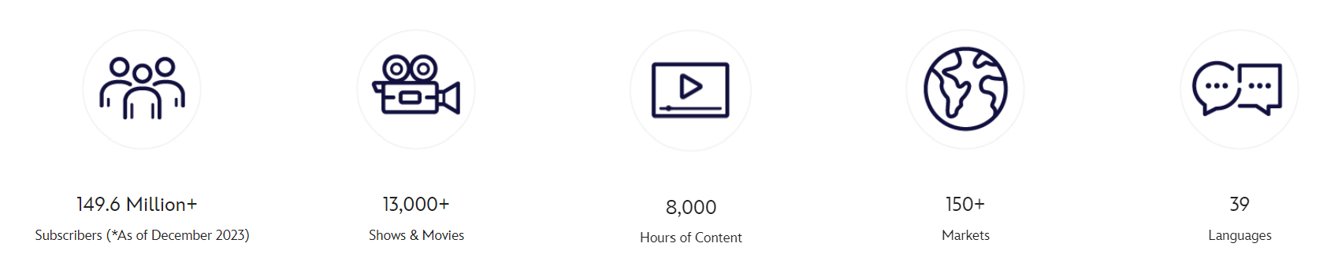
Introduction
Mercury is the closest planet to the Sun and the smallest one in the entire Solar System. Contrary to popular belief, this planet’s name has nothing to do with the liquid metal. Mercury was, instead, named after the famous Roman messenger god Mercurius
Mercury takes a little more than 58 days to complete its rotation, so try to imagine how long days must be there! Since the temperatures are so extreme, albeit not as extreme as on Venus, Mercury has been deemed to be non-habitable for humans

Slide 7


Product Comparison
Disney+
vs
Netflix
149.6 Million
Subscribers
260.3 Million
$ 7.0 monthly
Subscription Fee
$ 8.0 monthly
$ 8.4 Billion
2023 Revenue
$ 33.7 Billion

Slide 8
02
Methodology
Data science process and procedure

Slide 9
Methodology
Collection
Cleaning
Preprocessing
Web scraping of Subreddit posts
Remove duplicates and empty row
Feature and variables selection
Exploratory
Modeling
Evaluation
Data exploration and visualization
Model selection, fitting and training
Model performance assessment

Slide 10
03
Data Preparation
Data collection, cleaning and preprocessing

Slide 11

Public perception from Reddit
Every day, millions of people around the world post, vote, and comment in communities organized around their interests.

Slide 12
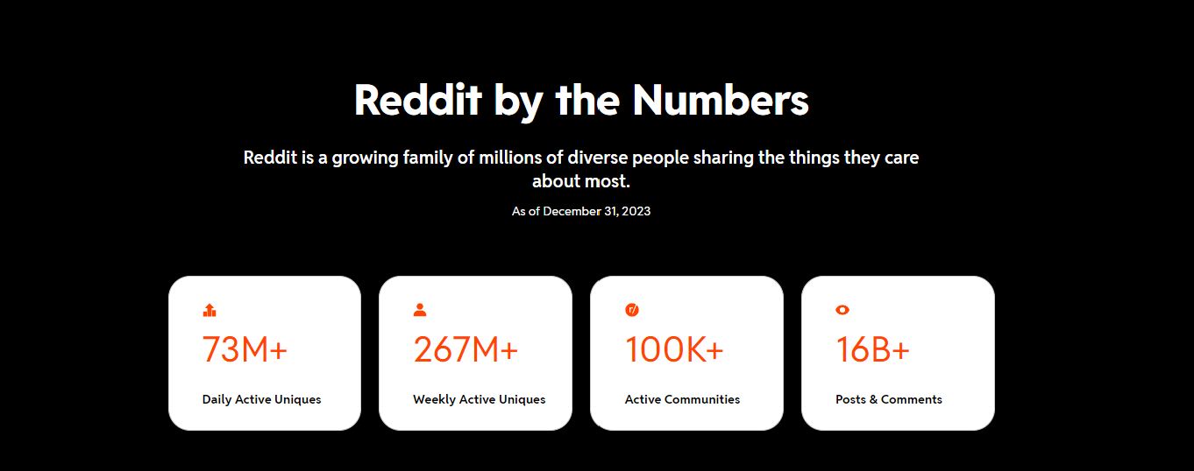


Slide 13
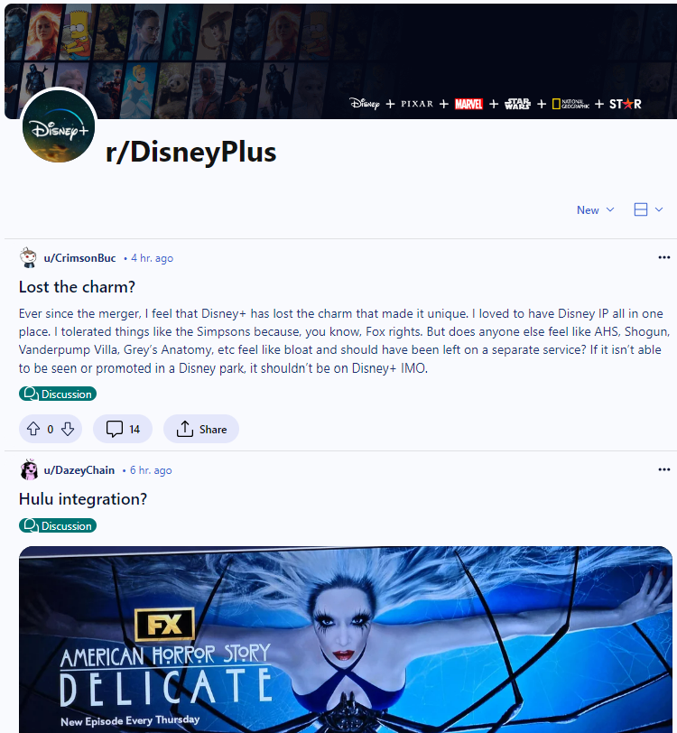
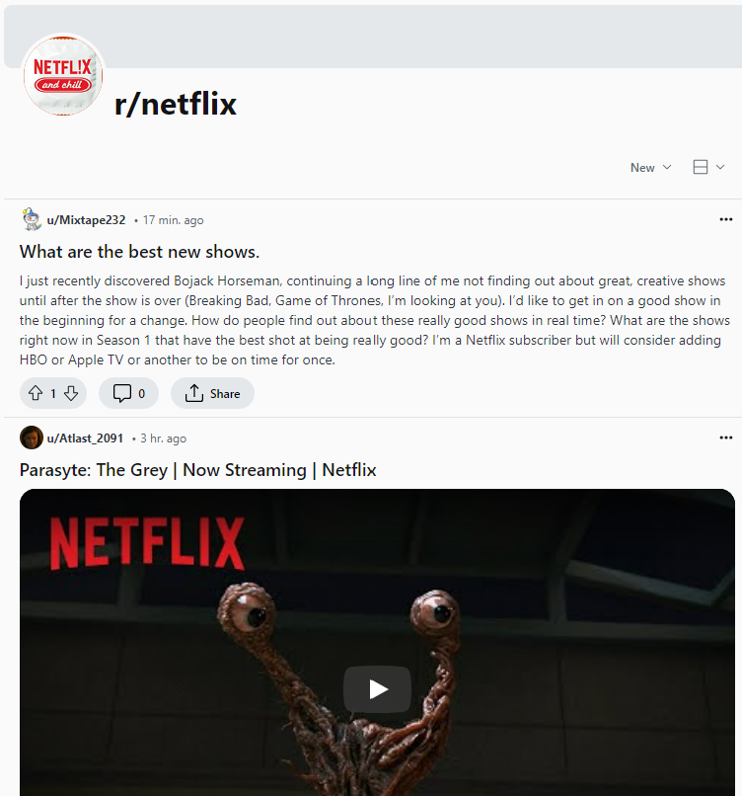
Data Collection - Subreddit
Subreddits are user-created areas of interest where discussions on Reddit are organized, and are denoted by “r/”
r/DisneyPlus vs r/netflix
Scrape the content

Slide 14
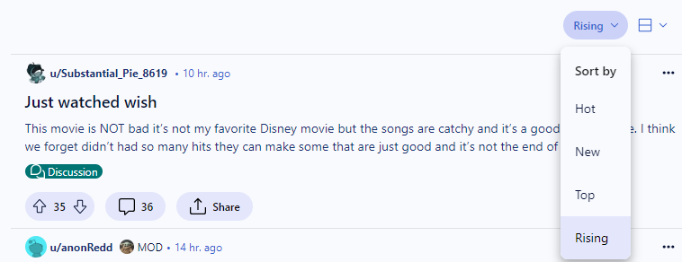
Data Collection - Web Scraping
Title
Type
Post title
4 different URLs to scrape based on type, 250 posts each
Upvote Ratio
Selftext
Ratio of upvotes to the total votes cast
Body text of the post

Slide 15
Data Preparation
Data Cleaning
Preprocessing
Remove duplicate entries based on the user id post
Combine Title and Selftext into one feature called “post” as our X variable
Remove the field with empty input
Add feature called “label” to classify post as Y variable

Slide 16
04
EDA
Data exploration and visualization

Slide 17
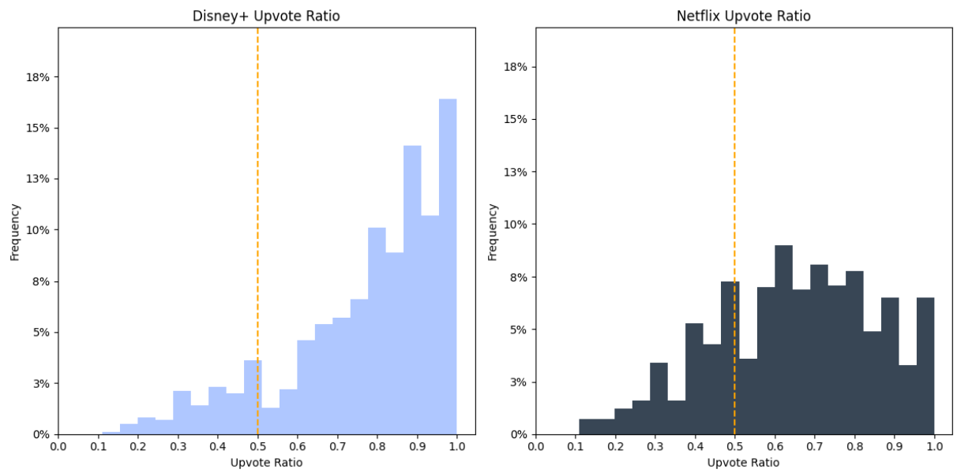
Data Exploration - Upvote Ratio
Represents the ratio of upvotes to the total votes cast
Majority of the posts have more upvotes - well liked by viewers
Average: 0.77
Average: 0.65

Slide 18
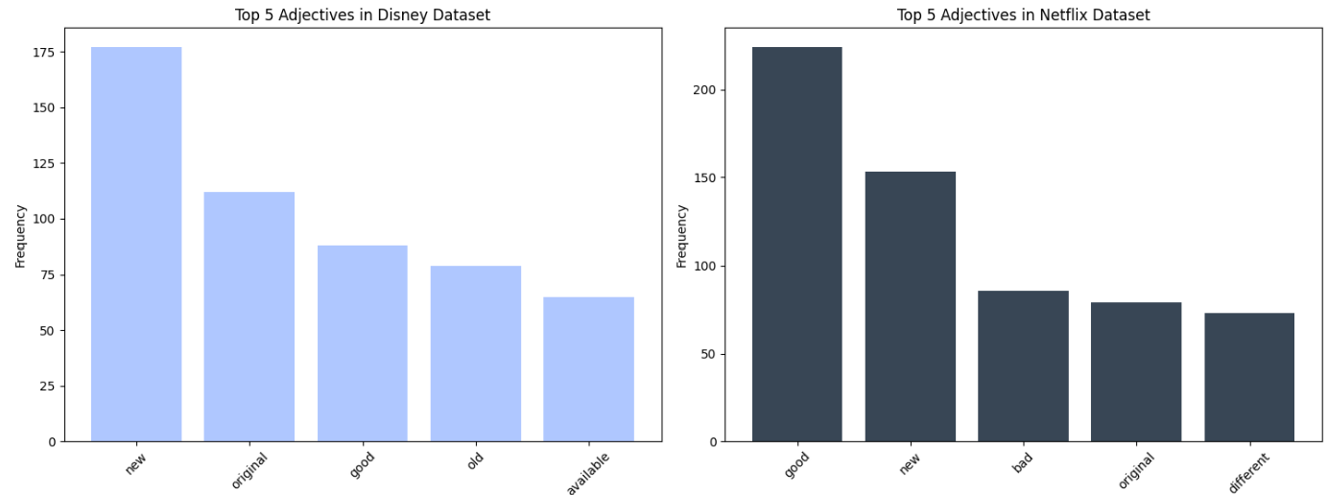
Data Exploration - Frequent Words
Tokenize, lemmatize and remove stop words
Disney+ has more “New” and “Original” but less of “Good”

Slide 19
Sentiment Analysis
0.187
Positive
0.204
Proportion of the text that expresses positive sentiment
0.083
Negative
0.124
Proportion of the text that expresses negative sentiment
1.0
Compound
1.0
Overall sentiment of the text, normalized between -1 and +1
Notes:
VADER Sentiment Analysis. VADER (Valence Aware Dictionary and sEntiment Reasoner) is a lexicon and rule-based sentiment analysis tool that is specifically attuned to sentiments expressed in social media, and works well on texts from other domains.
The VADER lexicon is an empirically validated by multiple independent human judges, VADER incorporates a "gold-standard" sentiment lexicon that is especially attuned to microblog-like contexts.
Combines the positive, negative, and neutral scores into a single value, normalized between -1 and +1.

Slide 20
05
Modeling
Model selection, training, and hyperparameter tuning

Slide 21
Modeling Overview
Train - Test
Model Fit
Tuning
Split the data into train and test with equal proportion of Disney+ and Netflix on both sets (~50-50)
Fit different combinations of vectorizer and classifier
Hyperparameter tuning on the best performing model combination

Slide 22
Modeling - Vectorizer
Algorithm used to convert text data into numerical vectors
CountVectorizer
TF-IDF
Counting how many times each word appears and put into a table
Assigning weights to each word based on its frequency

Slide 23
Modeling - Classifier
Algorithm trained to assign labels / categories to input data
Multinomial Naive Bayes
Logistic Regression
K-Nearest Neighbors
Random
Forest
Bootstrap Aggregating
Gradient Boosting

Slide 24
Final Model
Vectorizer
Classifier
TF-IDF
Logistic Regression
GridSearch
 | Train | Test | Cross Validation
Accuracy | 0.96 | 0.86 | 0.85
Notes:
TF-IDF gives higher weights to terms that are frequent in a document but rare in the corpus, effectively reducing the importance of common words like "the", "is", etc., and highlighting the importance of words that are more specific to the documents.
Text data is typically high-dimensional and sparse, meaning that most features (words or n-grams) have zero or very low frequency. Logistic regression can handle sparse data well, especially when using techniques like TF-IDF (Term Frequency-Inverse Document Frequency) to represent text features.
Logistic regression tends to be robust to noisy features because it estimates the probability of the class label based on the weighted sum of all features, effectively ignoring irrelevant features with low weights.Regularization: Logistic regression can be regularized using techniques like L1 (Lasso) or L2 (Ridge) regularization, which penalize large parameter values.

Slide 25
06
Evaluation
Model performance evaluation and recommendation

Slide 26
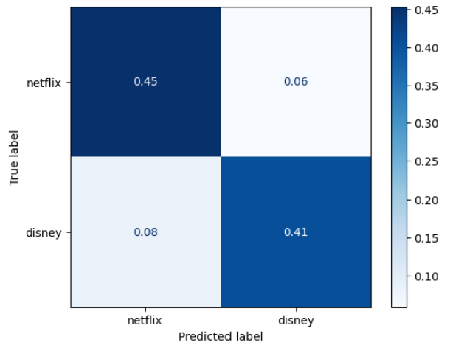
Evaluation - Metric
Accuracy
Confusion Matrix
Test: 0.86
Proportion of correctly classified instances
Rationale
Easy to interpret
Good for balanced datasets
Treats all prediction errors equally

Slide 27
Recommendation
Data insights
Predictive modeling
Provide insights on public perception and preferences towards Disney+
Predict public opinion or comments and perform classification
Optimization
Competition Analysis
Optimize marketing and content creation strategy towards a more targeted public
Study the competitor dynamics, customer experience and preference

Slide 28
Limitations
Data Generation
Variability
Biases
Data scraped for this analysis are <2,000 - to scrape more data on further studies / analysis
Reddit users come from diverse backgrounds and have different type of writing styles
Potential biases amongst communities towards certain items

Slide 29
Thank you!

